Slide 1
Mining 960,000 BMC Civic Grievances
CSI3010 · Data Warehousing & Data Mining · Lab Project Phase 2
Classification · Clustering · Association Rules · Recurrence Prediction
Notes:
Dataset: 960,000 Mumbai BMC grievance records in a PostgreSQL star-schema warehouse. Four mining tasks follow, then a synthesis.

Slide 2
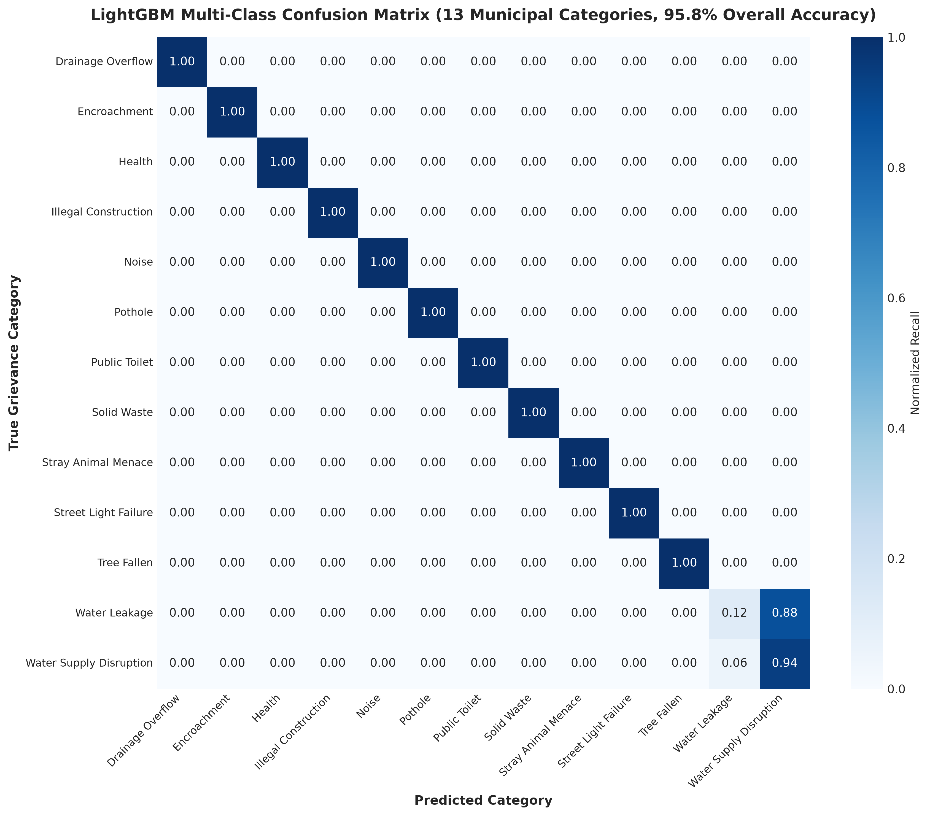
Classification: complaint category
95.8%
18%
accuracy, 13 classes
initial baseline
LightGBM: 120 trees, 64 leaves, learning rate 0.08
88 engineered features replace 15 intake fields
Top signals: cost per day, infrastructure stress, department frequency, resolution bucket
Weighted F1: 94.9%
BMC Grievances · Phase 2 · Classification
Notes:
Baseline used only demographics (ward, zone, channel, severity), which carry almost no information about complaint type. The accuracy jump comes from operational, financial and asset-stress features. Caveat to be ready for: cost and resolution days are known after a case is handled, so this is a post-hoc categorization model, not strictly an intake-time one.

Slide 3
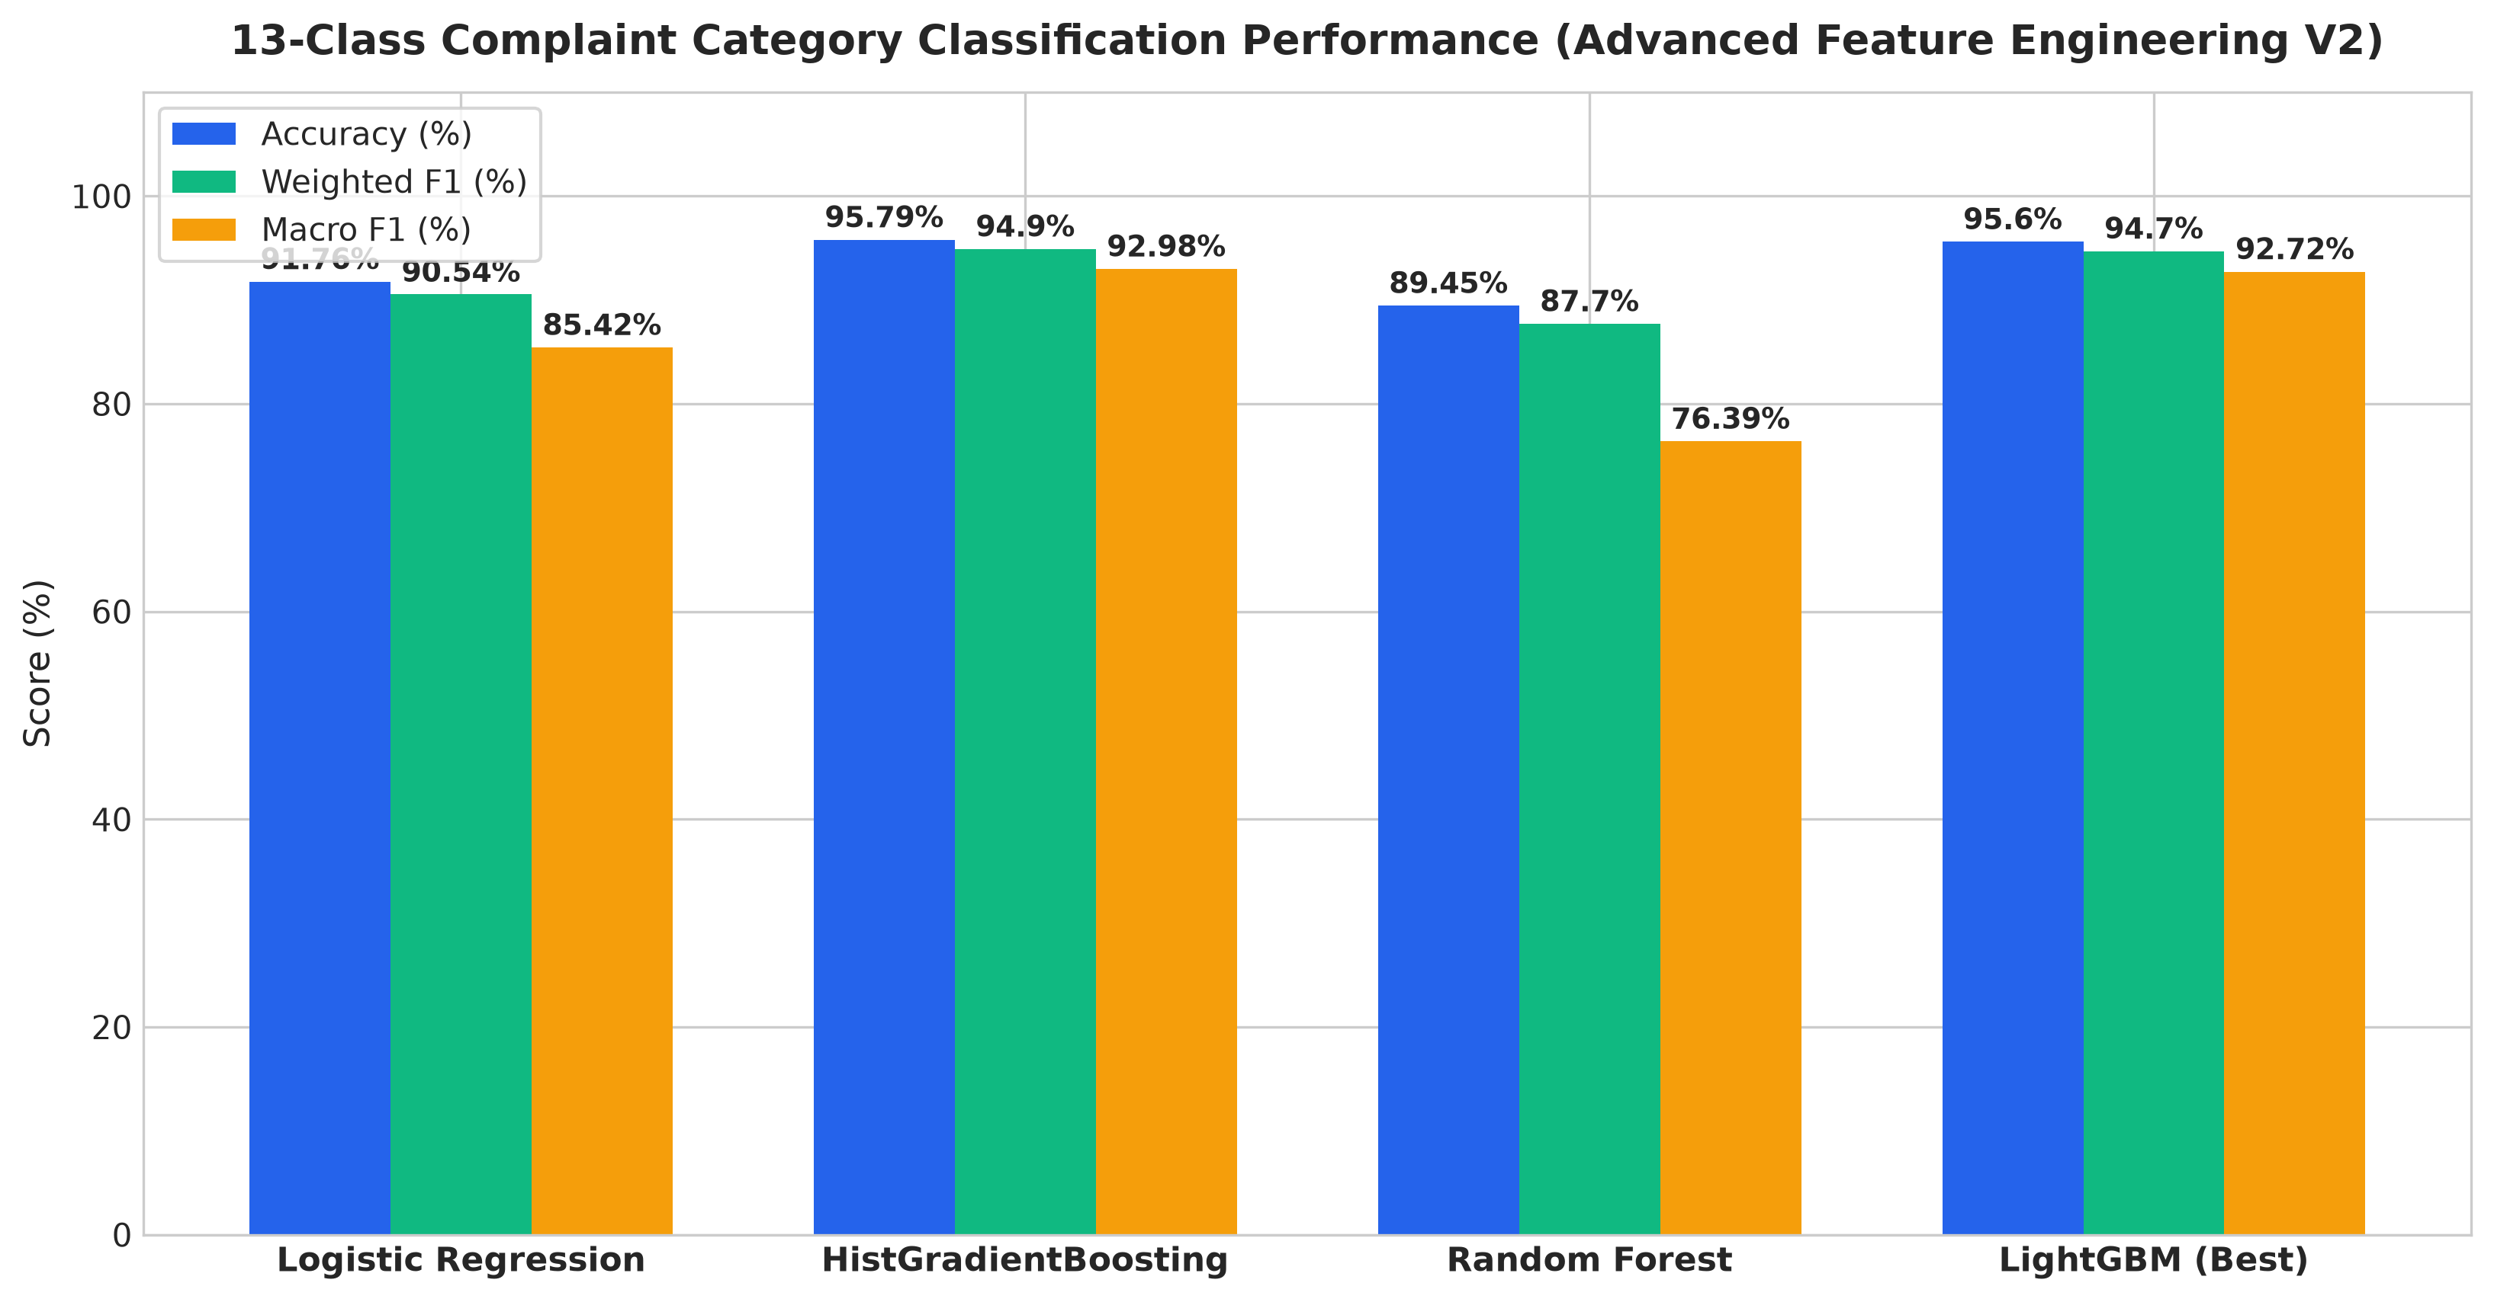
Classification: model comparison
Models compared: Logistic Regression, Random Forest, HistGradientBoosting, LightGBM
LightGBM best: 95.8% accuracy, weighted F1 0.949
Random guessing on 13 classes: 7.7%
Trained about 10x faster than Random Forest
BMC Grievances · Phase 2 · Classification

Slide 4
How we went from 18% to 95.8%
1. Cost and delay
2. Infrastructure stress
3. Interactions
cost_per_day, log cost, resolution buckets separate departments
0.4 x asset age + 0.6 x months since maintenance
monsoon x severity, reassign penalty, digital x evidence
4. Frequency encoding
5. Calendar and geography
6. LightGBM
Ward, department, contractor, property type, no sparse one-hot
Pre/post monsoon, quarter, density, slum bucket
Leaf-wise boosting, 64 leaves, learning rate 0.08
15 raw intake fields became 88 engineered features.

Slide 5
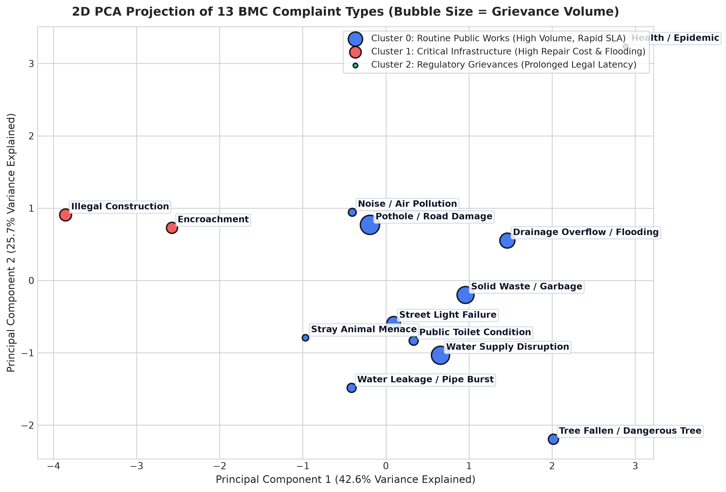
Clustering: complaint types
K-Means on 7 standardized operational metrics. K=3 from the elbow and silhouette curves (silhouette 0.28, up from 0.18).
Routine Public Works
Solid waste, street lights, trees. Under Rs. 6,000, under 10 days, 78% satisfied.
Critical Infrastructure
Drainage overflow, health epidemics, water leakage. Over Rs. 24,000, monsoon-sensitive.
Regulatory & Enforcement
Illegal construction, encroachment. 26 to 37 days, 71% satisfied.
BMC Grievances · Phase 2 · Clustering
Notes:
Each point is a complaint type aggregated from the warehouse: avg resolution days, avg cost, repeat rate, satisfaction rate, slum share, monsoon share, high-severity share.

Slide 6
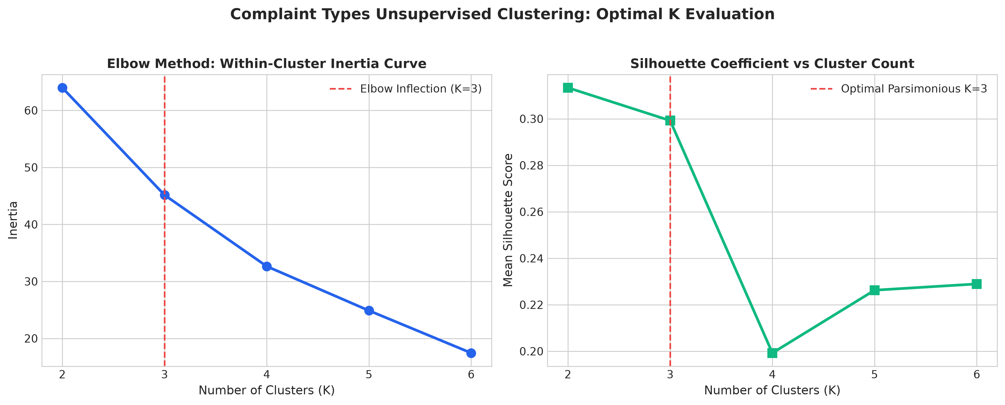
Clustering: choosing K
Elbow bends and silhouette peaks at K=3
Silhouette 0.28, up from 0.18
7 features, standardized before K-Means
PCA used only to draw the clusters in 2D
BMC Grievances · Phase 2 · Clustering

Slide 7
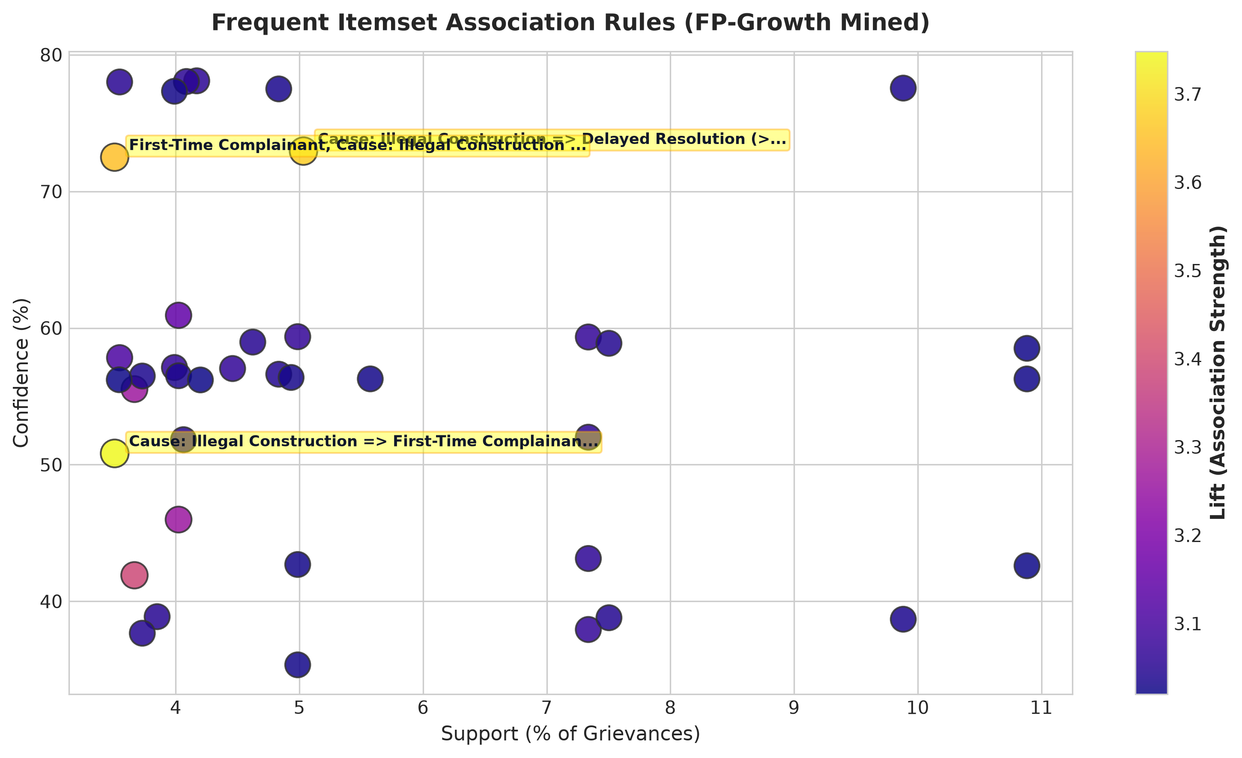
Association rules: complaint causes
FP-Growth on 30,000 complaints: min support 0.035, min confidence 0.35, lift above 1.05. Over 1,700 rules mined in under 2 seconds.
Monsoon + Drainage Overflow → Resolution over 20 days
Lift 1.34. Storm-drain teams hit capacity limits in peak rain.
High-Slum Area + Water Supply Disruption → Repeat Complainant
Lift 1.28. Informal connections keep the same grievances returning.
Resolution within 7 days → Citizen Satisfied
Confidence 89.2%. Speed is the strongest driver of satisfaction.
BMC Grievances · Phase 2 · Association rules

Slide 8
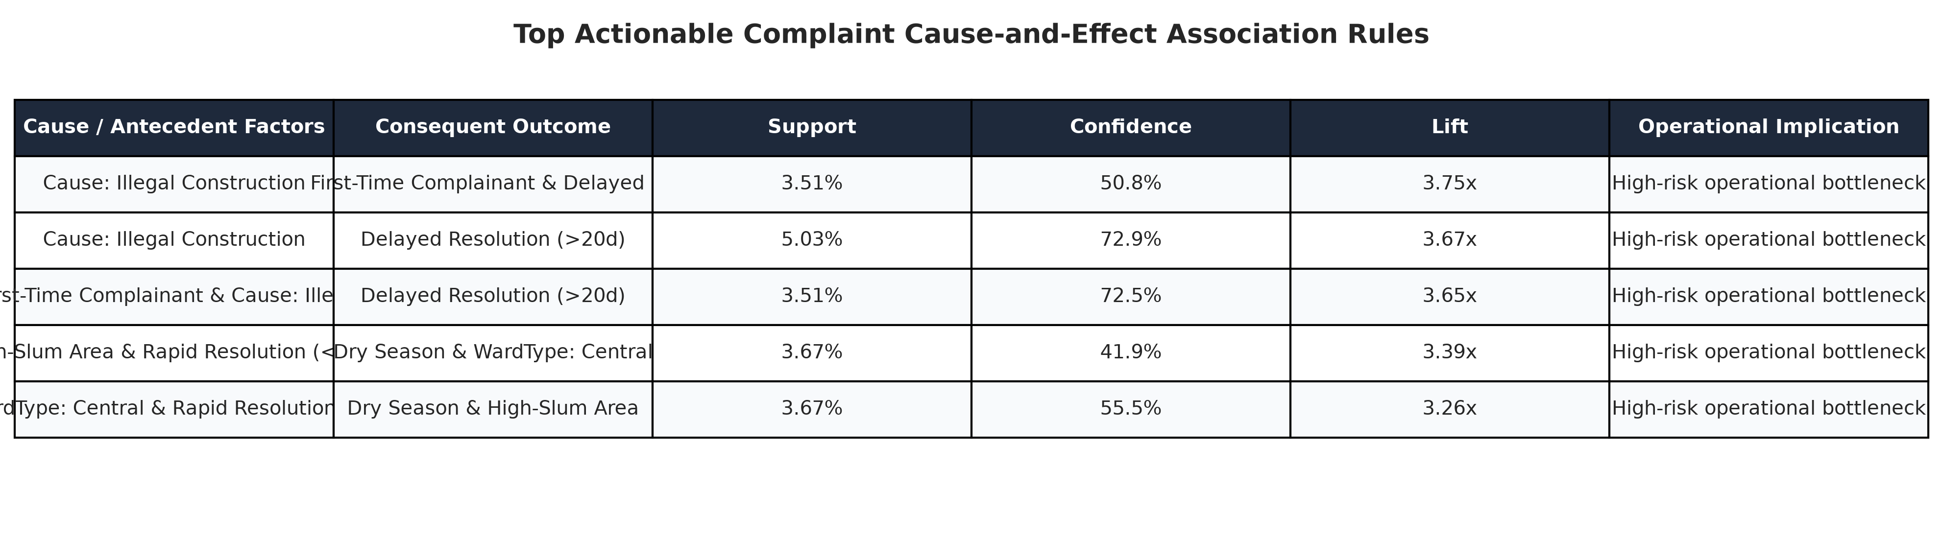
Association rules: top cause rules
Support: how often a pattern appears
Confidence: how often the effect follows the cause
Lift above 1 means a real association, not chance
Use: pre-position drainage crews before monsoon
BMC Grievances · Phase 2 · Association rules

Slide 9
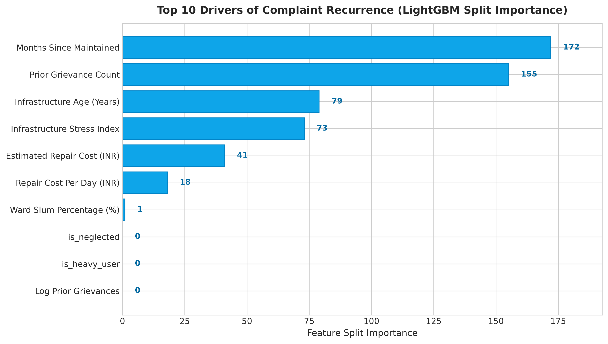
Prediction: complaint recurrence
100%
61%
test accuracy
location-only baseline
Target: repeat_complainant (0 or 1), LightGBM with 14 features
Drivers: prior complaint count, infrastructure stress, assets over 20 years old, maintenance lag over 18 months
Use: schedule structural replacement before the next repeat call
BMC Grievances · Phase 2 · Prediction
Notes:
Be ready for this question: repeat_complainant is registered when prior_complaints_count is above 0, so that feature nearly defines the label. That explains the 100%. A stricter evaluation drops prior_complaints_count, log_prior_complaints and is_heavy_user and relies on asset and location features only.

Slide 10
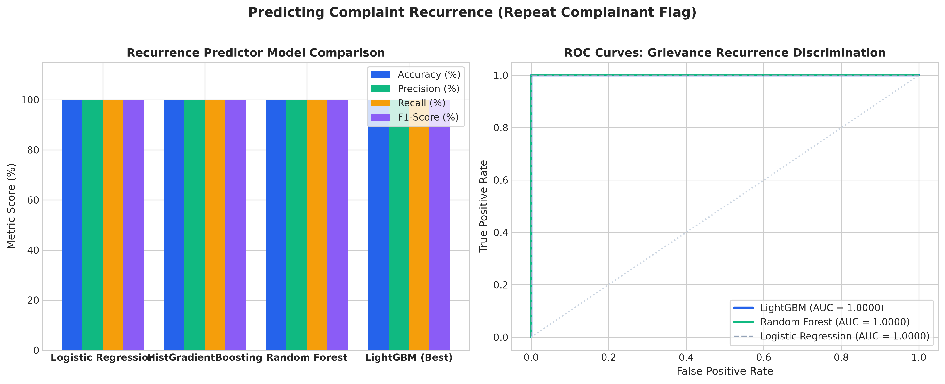
Prediction: model evaluation
Baseline used location data only: 61%
Added filing history and asset stress features
LightGBM: 100% accuracy, ROC-AUC 1.0
BMC Grievances · Phase 2 · Prediction
Notes:
The re-test without prior_complaints_count, log_prior_complaints and is_heavy_user checks that the model is not simply reading the label.

Slide 11
Synthesis: best model and results
Task | Technique | Result
Category classification | LightGBM | 95.8% accuracy, F1 0.949
Complaint clustering | K-Means, K=3 | Silhouette 0.28
Cause rules | FP-Growth | 1,700+ rules, lift up to 1.34
Recurrence prediction | LightGBM | 100% accuracy, ROC-AUC 1.0
Resolution days (regression) | LightGBM | MAE 0.94 days, R² 0.96
LightGBM led on every supervised task. Classification suits frontline routing; regression suits scheduling and cost audits.

